Slide 1
Bank loan of customers data analysis project
P- 149P | Group 2 | Mentor: Hafeez

Slide 2
WEALTH IS THE ABILITY TO FULLY EXPERIENCE LIFE.
-Henry David Thoreau

Slide 3
CONTENTS
Introduction
Meet the team
KPI-1 : Year wise loan amount Stats
KPI-2 : Grade and sub grade wise revol bal
KPI-3 : Total Payment for Verified Status Vs Total Payment for Non Verified Status
KPI-4 : State wise and Month wise Loan status
KPI-5 : Home ownership vs Last payment date stats
Dashboards & Queries : Excel, SQL, Power BI & Tableau

Slide 4
INTRODUCTION
The project aim to analyze the Finance dataset of bank loan of customers, through a report to get insights from it by using different software tools such as Excel, MySQL, Tableau and Power Bi.
We used for analyzing, cleaning and removing duplicates from datasets and prepared dashboards and insights accurate business decisions are made.

Slide 5
Data set
Data Set | Finance_1 | Finance_2
No. of Rows | 39k | 39k
No. of Columns | 24 | 25
File Format | .csv | .xlsx
Dataset type | Excel Data | Excel Data

Slide 6
Tools used in the project
Excel
MySQL
Tableau
Power-BI
Data Exploration
Data Cleaning
Visualization
Data Exploration
Retrieving Relevant Data according to KPIs
Joining multiple Files
Visualization
Joining multiple Files
Data Exploration
Data Cleaning in Power Query
Visualization

Slide 7





Data analysis process
Step 1
Step 2
Step 3
Step 4
Step 5
Define the Question
Collect the data
Clean the data
Analyze the data
Visualize and Share the Insights

Slide 8







MEET OUR TEAM
Mr. Shreyash Arjun Naikwadi
Mr. Naveen M C
Mr. Sabarish K P
Mr. Kanchu Sai Charan
Mr. Dasharath Bhavarlal Khatri
Mr. Nikesh Narayan Gathadi
Mrs. Venkata Lakshmi Anusha Macherla

Slide 9
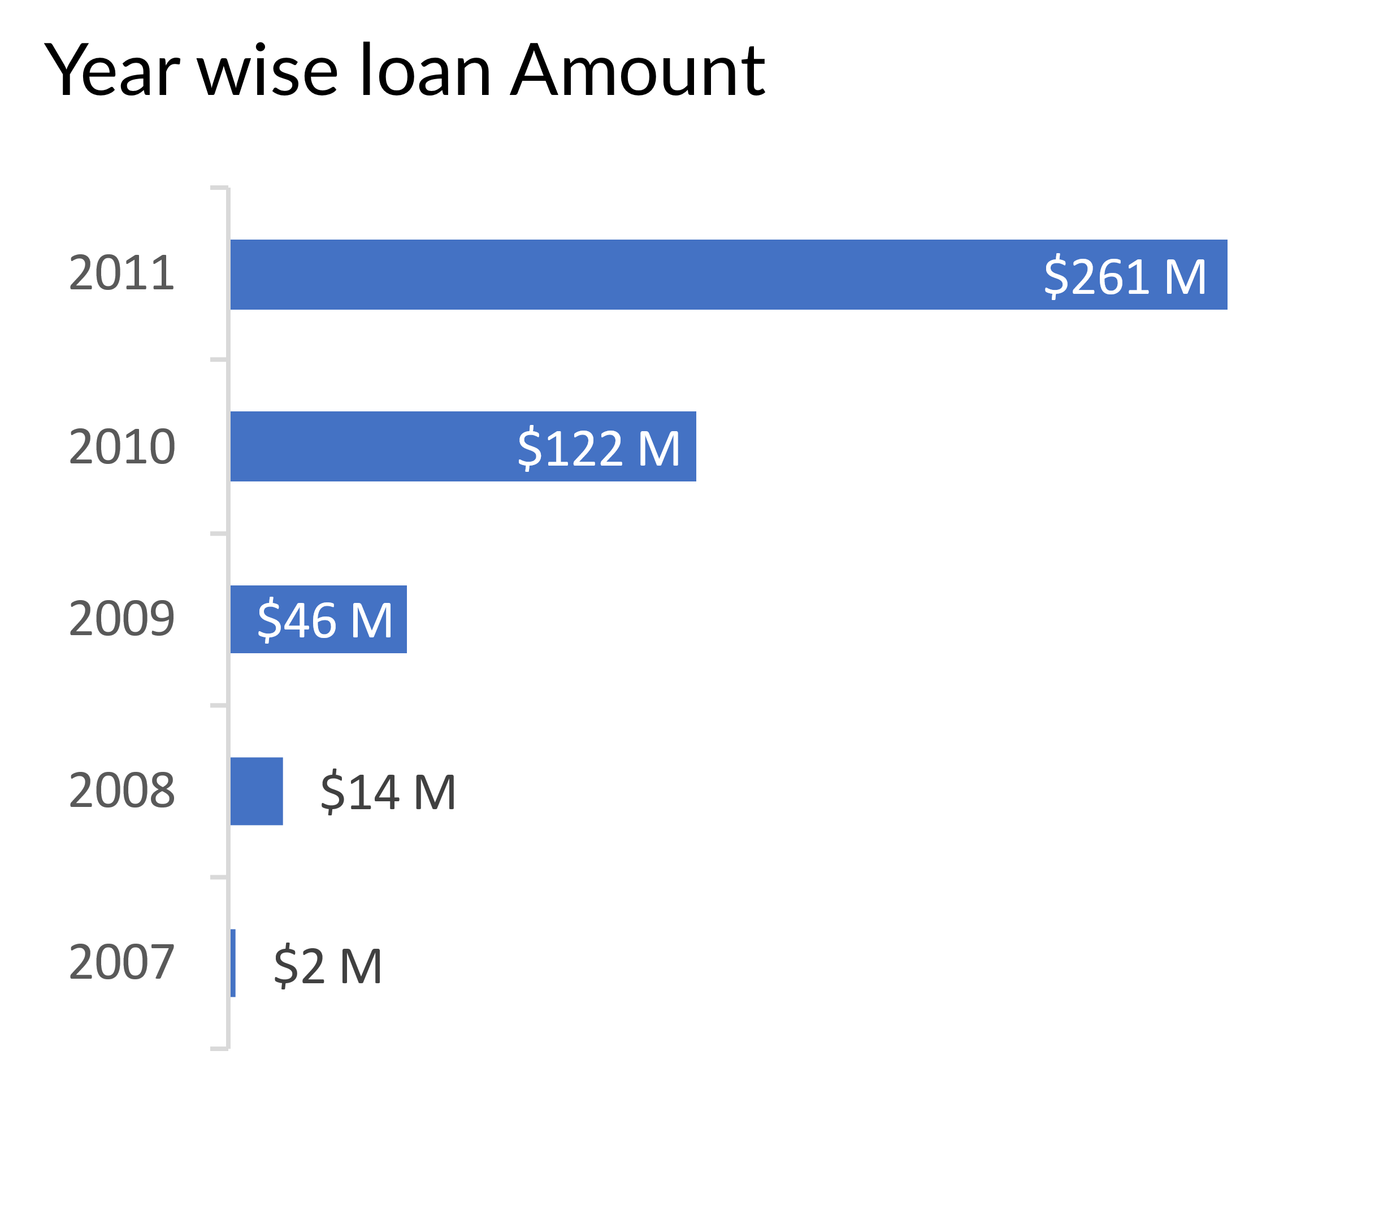
KPI-1 : Year wise loan amount Stats
By observing this chart we can see how loan amount is increasing by year.
It is continuously increasing by each year as you see it‘s varies from 2 M to 261 M between the years 2007 to 2011.
From the year 2009, The changes in loan amount is suddenly increased with a higher rate that is around 5 times for next 2 years as compared to pervious years.

Slide 10
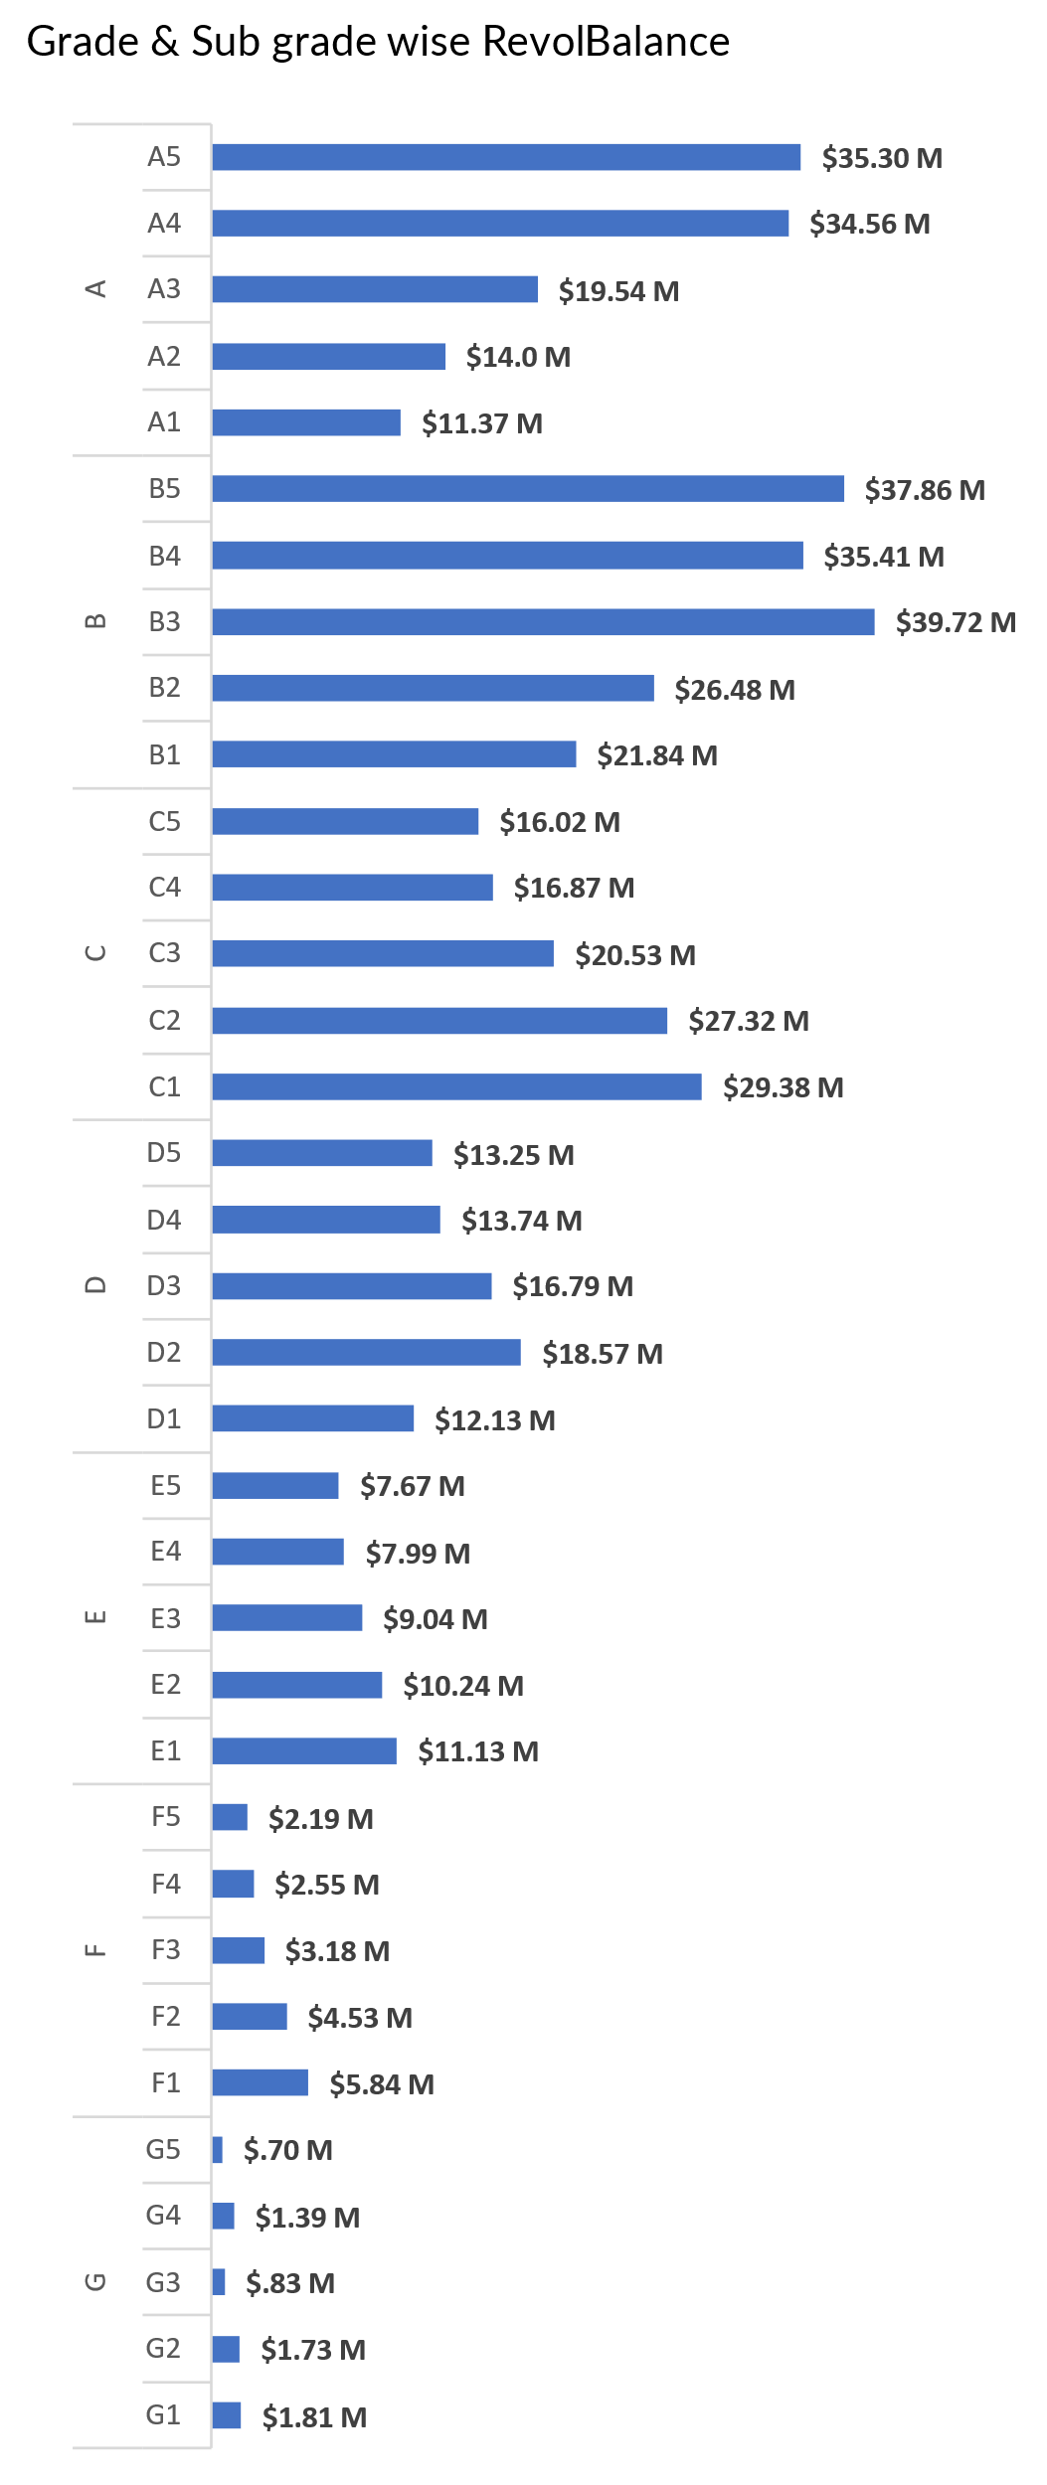
KPI-2 : Grade and sub grade wise revol_bal
In this Grade and subgrade wise revol balance we can notice Grade B have more revol balance then any other grades & Grade G have very low revol balance.
The average revolving balance is higher in the ‘grade B’ its around 29M and the maximum reaches in the ‘sub-grade B1’ that is 39M, Same like the average lower revolving balance is in ‘grade G’ its around 1200K and the minimum reaches in the ‘sub-grade G5’ that is 701k.

Slide 11
KPI-3 : Total Payment for Verified Vs Non Verified Status
As we Can see in the Donut Chart that Out of $373 Million only 59% are verified i.e. $220million
41% of $373 Million are not verified i.e. $ 154 Million. Which might be a threat to company, Should inform the verification team to take required action regarding that.

Slide 12
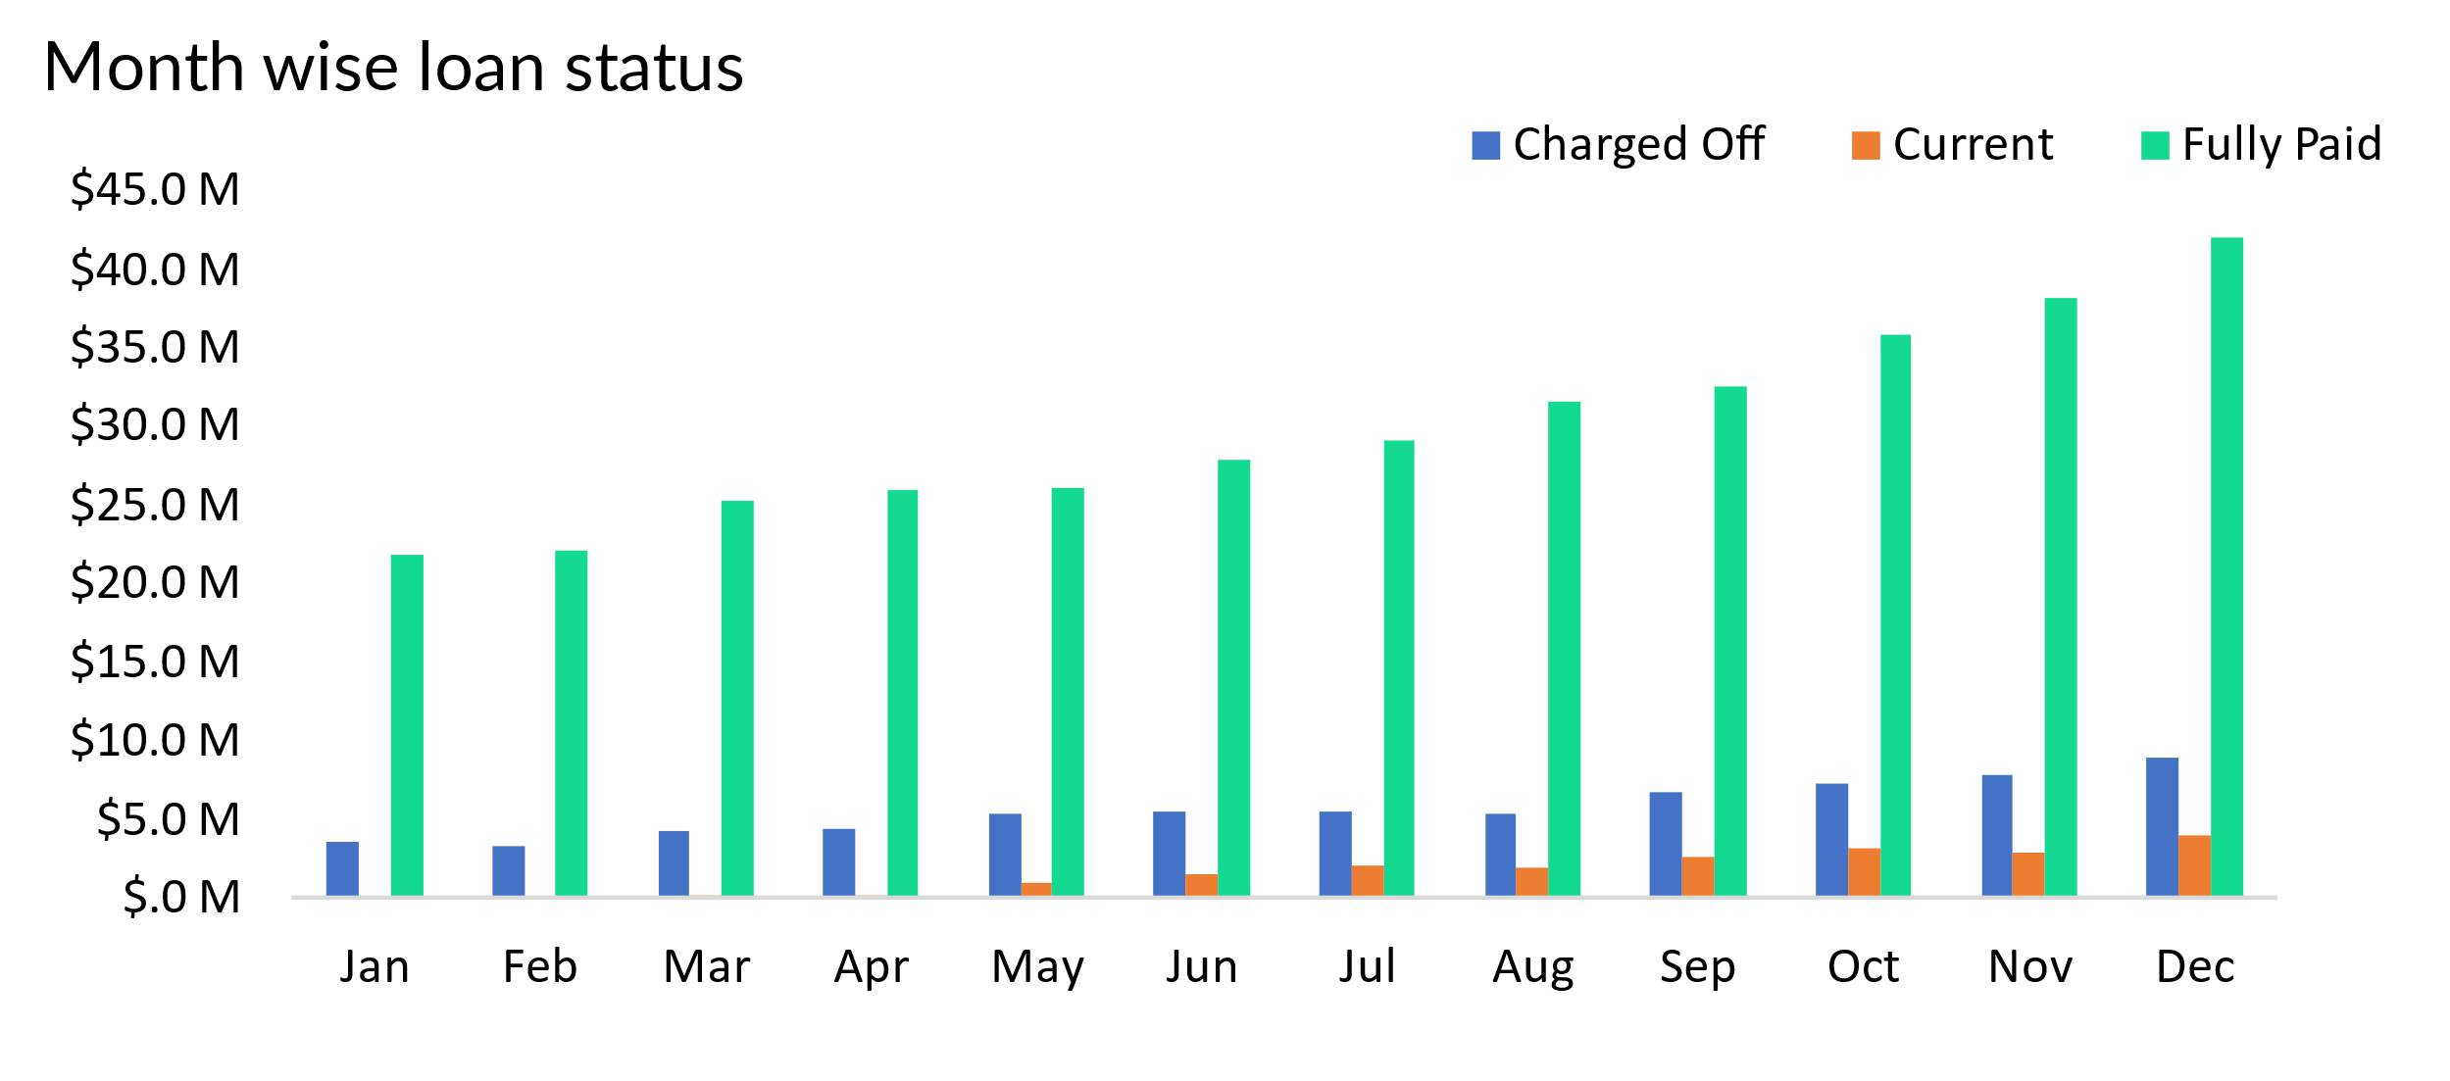
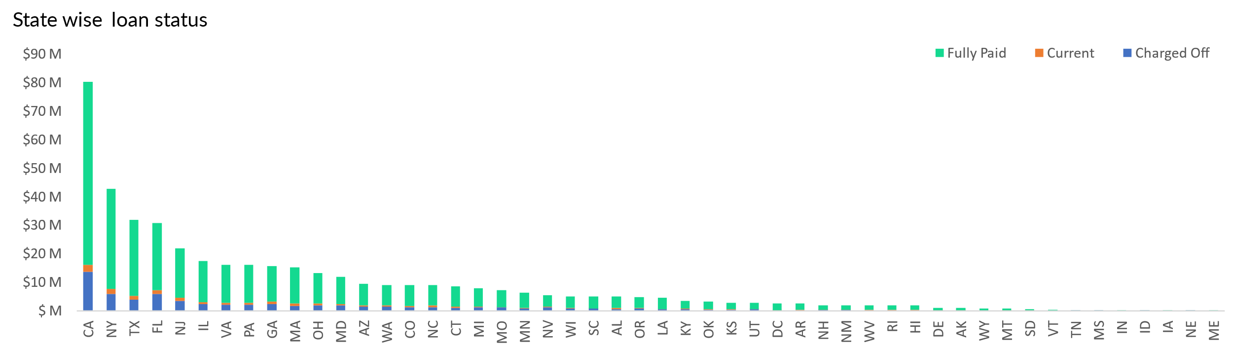
KPI-4 : State wise and MONTH wise loan status
In the data set we have different states and the months along with the 3 types of loan status.
In the state wise loan status we can observe that CA,NY,TX,FL & NJ are the top states to fully paid amount.
In the month wise loan status we can observe that Dec, Nov and oct are the fully paid amount.

Slide 13
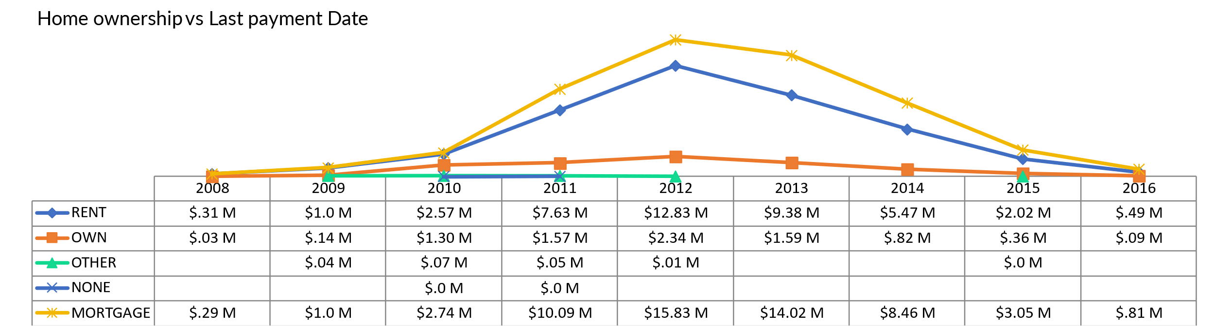
KPI-5 :
Home ownership Vs last payment date stats
In this chart is shown by the types of home ownerships varies from 2008 to 2016.
In maximum amount reaches in the year 2012 who Rent and Mortgage house owners has paid their last Payment is 12 million and 15 million. And the minimum amount reaches in year 2008 and payment is 0.29 million and 0.31million.

Slide 14
Dashboard & Queries
Excel, Tableau, Power-BI & SQL

Slide 15
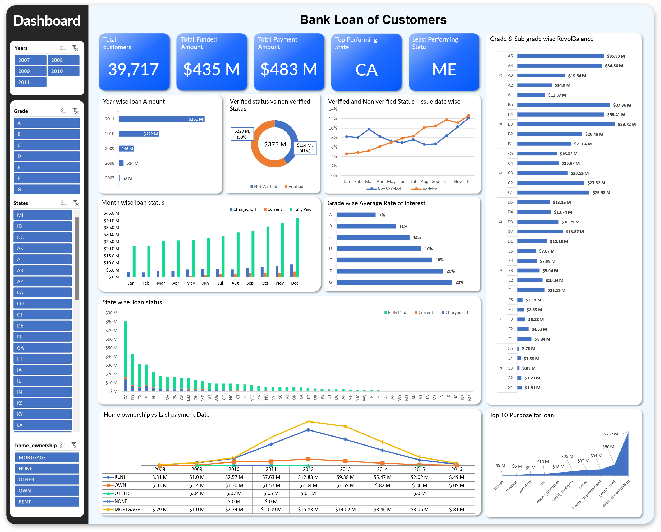
Excel Dashboard

Slide 16
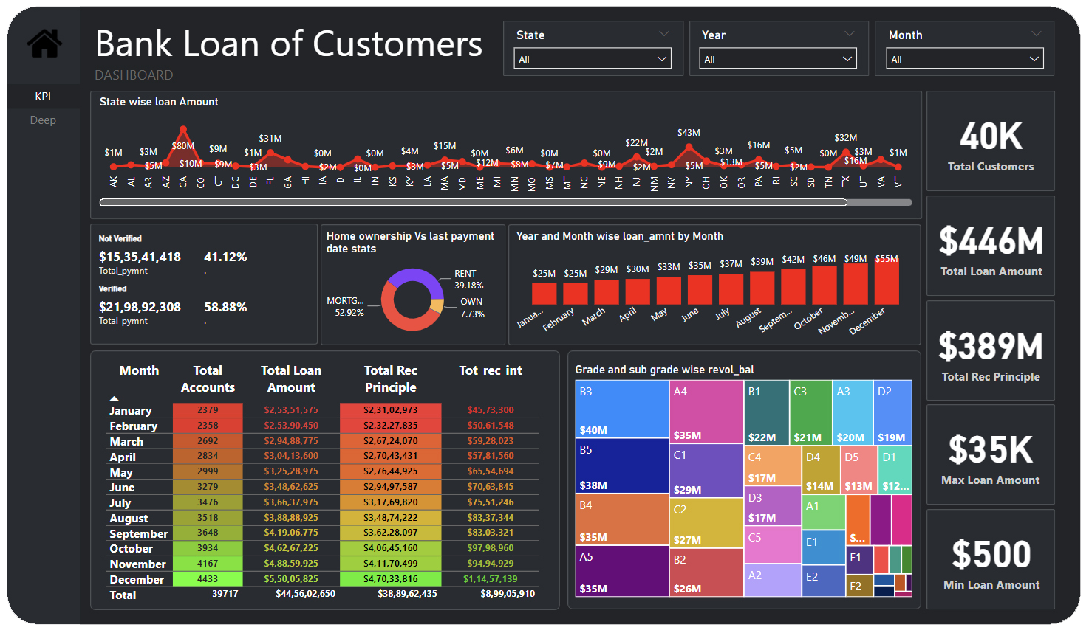
POWERBI Dashboard

Slide 17
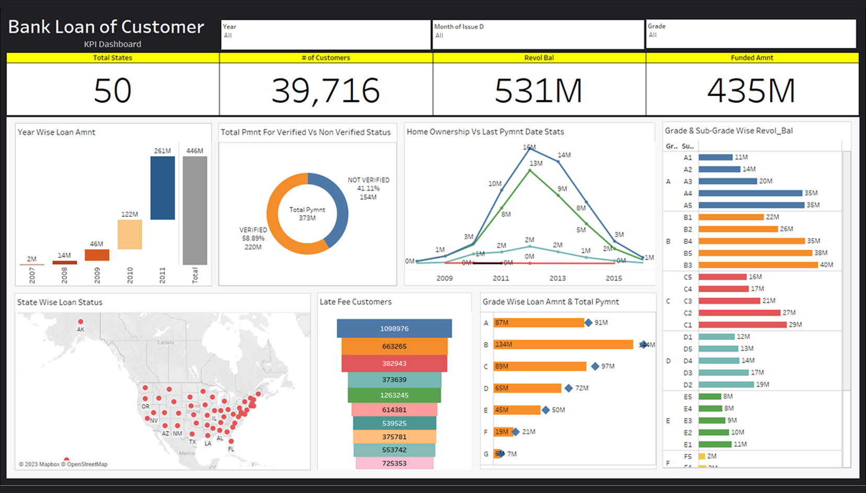
TABLEAU Dashboard

Slide 18
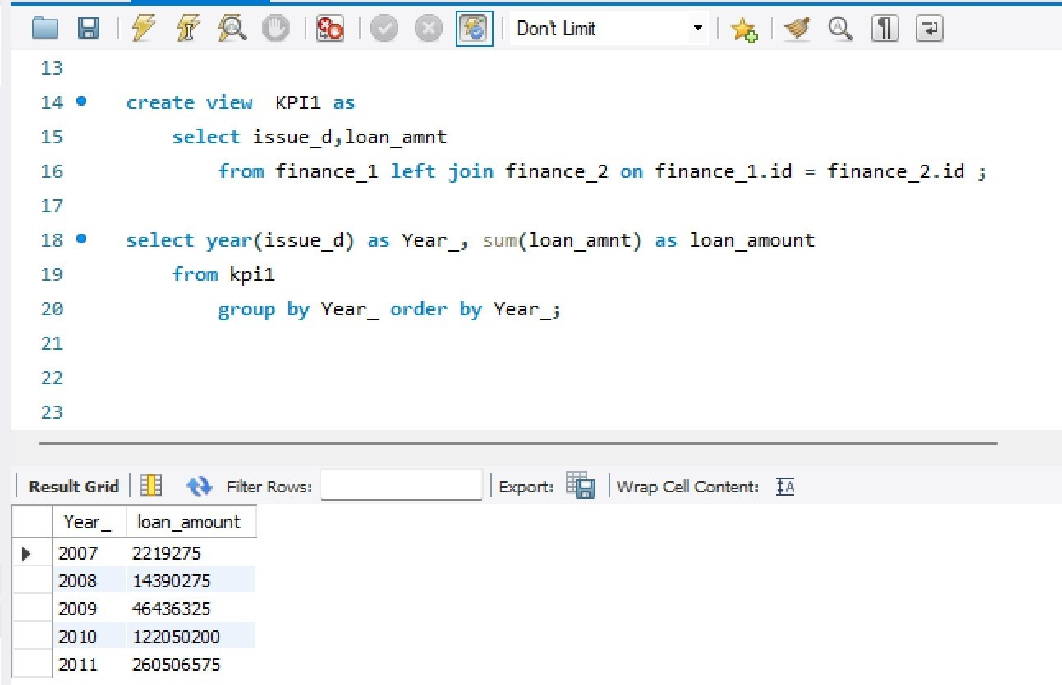
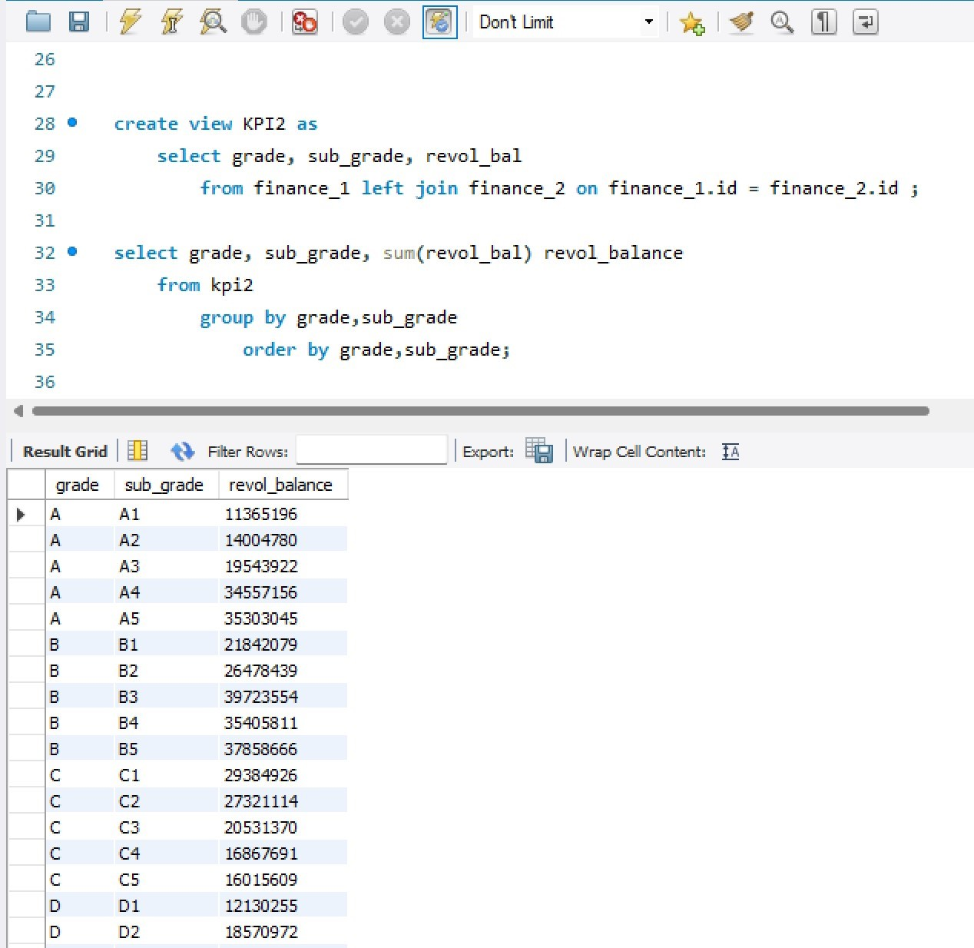
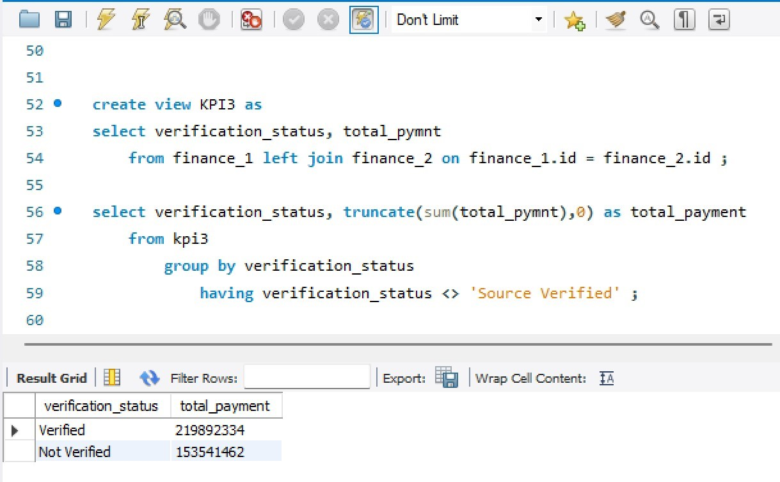
SQL Queries and results

Slide 19
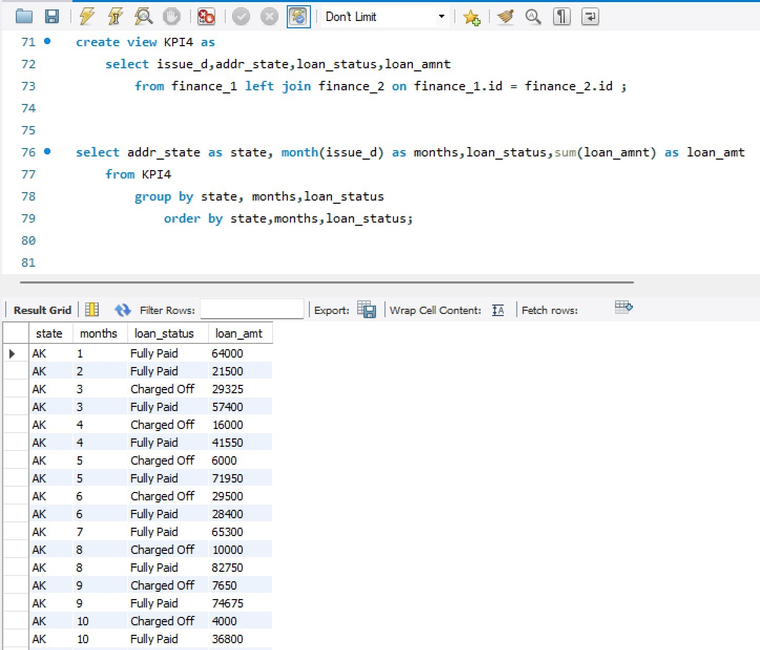
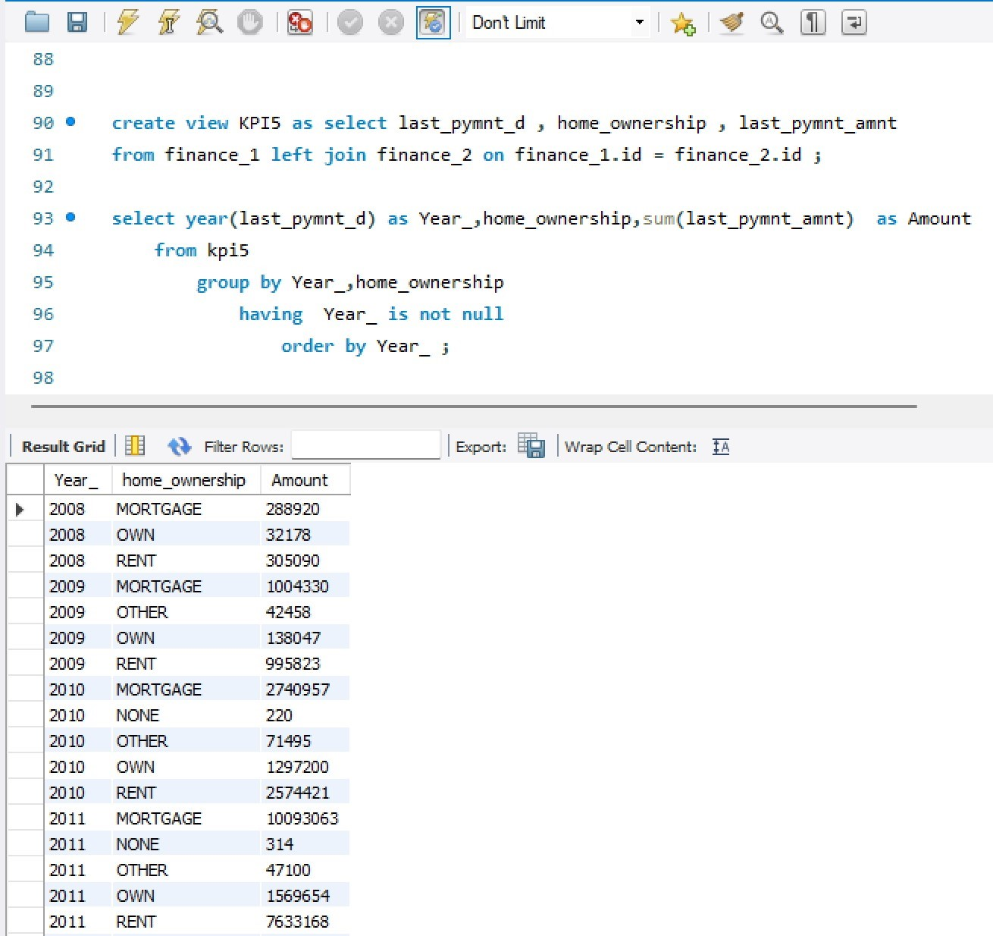
SQL Queries and results

Slide 20
cONclusiON
Banking holds a crucial role in our day-to-day life. From the analysis of above dashboards and reports we can draw hidden insights. With the use of gained insights from the finance datasets and KPI’S. Accurate Business decisions are made and can track the business state. It enables a holistic view of the business, supporting long-term growth and competitiveness in the banking industry.

Slide 21
THANK YOU

